Slide 1

Vel Tech Rangarajan Dr. Sagunthala R&D Institute of Science and Technology
School of Computing
Department of Computer Science and Engineering
10211CS224 / FULL STACK APPLICATION DEVELOPMENT (JAVA)
PROJECT REVIEW : MILESTONE PROJECT – 1
Date: 25-03-2026
Automated Quiz Engine with PDF Certification Generation
SDG: Sustainable Development Goal 4: Quality Education
Presented By:
SHAIK SANHEERA
VTU26379
23UECS1205
Courses Handling Faculty:
Mr. S. Manohar M.E., (Phd)
Assistant Professor

Slide 2
INTRODUCTION
Traditional examination methods often depend on manual paper checking, which can take a lot of time and may lead to mistakes. With the rapid growth of digital education, there is an increasing need for systems that can conduct assessments automatically and efficiently. To address this issue, this project proposes an Automated Quiz Engine with PDF Certification Generation. The system allows users to take quizzes online and receive their results immediately. It automatically checks the answers and calculates the score. If the user meets the required criteria, a PDF certificate is generated instantly. This solution helps improve digital learning and supports modern technology-based education systems.
1
2
3
4
5
6
7
8
9

Slide 3
PROBLEM STATEMENT
Many educational institutions still depend on manual or partially digital methods to conduct quizzes and evaluate student performance. This process often takes a lot of time and may lead to errors, while also lacking the ability to provide instant feedback to students. In addition, creating certificates manually increases the workload for administrators and delays recognition for learners. Without proper automation, managing data and tracking results becomes difficult and inefficient. Therefore, there is a need for a secure and reliable automated quiz system that can simplify the assessment process, improve accuracy, and instantly generate PDF certificates for successful participants.
1
2
3
4
5
6
7
8
9

Slide 4
OBJECTIVE(S)
To design and develop a web-based Automated Quiz Engine that allows users to take online quizzes and receive instant evaluation of their answers.
To implement an automated system that generates and provides PDF certificates to users based on their quiz performance.
1
2
3
4
5
6
7
8
9

Slide 5
PROPOSED SYSTEM
The system is designed using a three-tier architecture that includes the Presentation Layer (Frontend), Application Layer (Backend), and Database Layer.
The Presentation Layer, built using HTML, CSS, provides the user interface for login, taking quizzes, viewing results, and downloading certificates.
The Application Layer, developed using PHP, manages user authentication, quiz operations, answer verification, score calculation, and PDF certificate generation.
The MySQL database securely stores important data such as user information, quiz questions, answers, scores, and certificate details.
After the user submits the quiz, the system automatically evaluates the answers and displays the results instantly.
If the user meets the required passing criteria, the system generates a downloadable PDF certificate automatically.
An admin module is included to manage the quiz system by adding questions when required.
Overall, this architecture reduces manual effort, improves accuracy, increases efficiency, and provides a faster and more reliable assessment process compared to traditional methods.
1
2
3
4
5
6
7
8
9

Slide 6
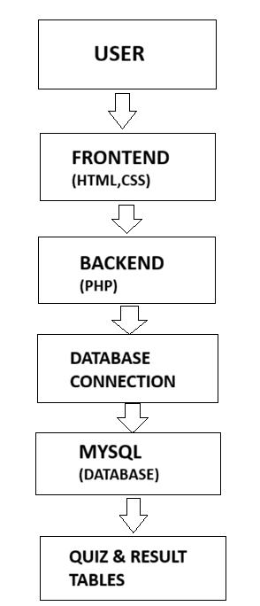
PROPOSED SYSTEM ARCHITECTURE
1
1.User/Browser
The process begins when the user (student/admin) accesses the system through a web browser.
2. Frontend (HTML, CSS)
The frontend provides the user interface for login, quiz participation, viewing results, and downloading certificates.
3. Backend (PHP)
The backend processes user requests such as authentication, quiz handling, answer evaluation, and score calculation.
4. Database Connection
The backend connects to the database to store and retrieve required information.
5. MySQL Database
The database stores user details, quiz questions, answers, results, and certificate records.
6. Output (Result & Certificate)
After processing, the system displays the quiz result and generates a PDF certificate for qualified users.
2
3
4
5
6
7
8
9

Slide 7
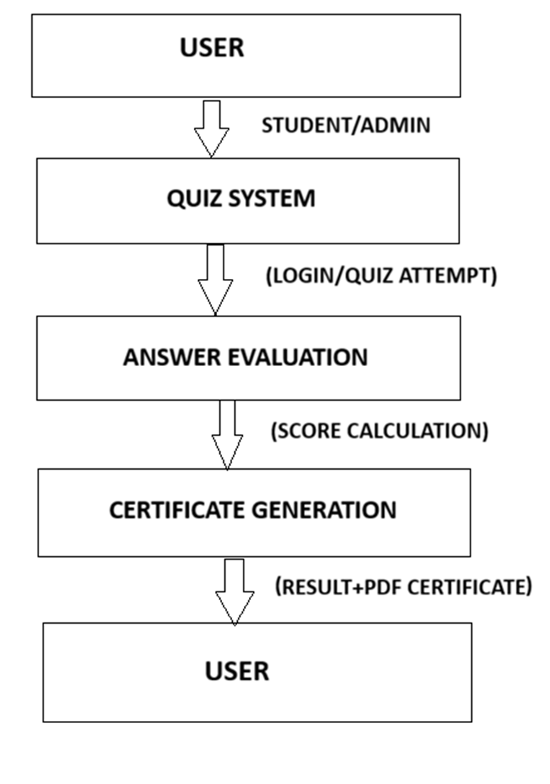
WORKFLOW
1
The Data Flow Diagram explains how data flows through the system. First, the user logs in and takes the quiz. The system then checks the answers and calculates the score. All the information is stored in the database for future use. Based on the score, the system determines the result. Finally, the result is displayed, and a PDF certificate is generated for the user.
2
3
4
5
6
7
8
9

Slide 8
TECHNOLOGIES USED
Frontend
HTML5 – Used to create the structure of web pages
such as registration, login, quiz, and admin pages.
CSS3 – Used to style the interface and improve
visual appearance.
Bootstrap 5 – Used for responsive design and UI
components like cards, forms, and buttons.
Tools
XAMPP – Local development environment that includes Apache server, PHP, and MySQL.
phpMyAdmin – Tool used to create and manage the MySQL database.
InfinityFree – Used for deploying and hosting the project online.
FPDF Library – Used to generate downloadable PDF certificates.
Web Browser (Chrome/Edge) – Used for testing and running the web application.
Code Editor (VS Code / Notepad++) – Used to write and edit the project code.
1
2
3
4
Backend
PHP – Used to implement server-side functionality such as:
User registration and login authentication
Admin login and question management
Quiz question retrieval
Score calculation
Result processing
PDF certificate generation
5
6
7
Software Requirements
Windows Operating System
XAMPP Server
Web Browser (Google Chrome / Microsoft Edge)
Code Editor (VS Code / Notepad++)
InfinityFree Hosting Account
Database
MySQL – Used to store and manage data such as:
User information
Admin credentials
Quiz questions and options
Quiz results and scores
Certificate details
8
9

Slide 9
MODULE DESCRIPTION
Module 1: User Management
Handles user registration and login with secure authentication. It allows users to create accounts, log in to the system, and access the quiz interface. Session management is used to maintain user login status and restrict unauthorized access.
Module 2: Quiz Management
Manages quiz-related operations such as displaying quiz questions, collecting user responses, and validating answers. The system retrieves questions from the database and allows users to attempt the quiz through an interactive interface.
1
2
3
4
5
6
Module 3: Result Processing & Certificate Generation
Processes quiz submissions, calculates scores and percentages, and stores results in the database. If the user meets the passing criteria, the system generates a downloadable PDF certificate using the FPDF library.
Module 4: Admin Management
Allows the administrator to manage the quiz system. The admin can log in securely, add new quiz questions, and monitor system data. This module ensures proper control over quiz content and system functionality.
7
8
9

Slide 10
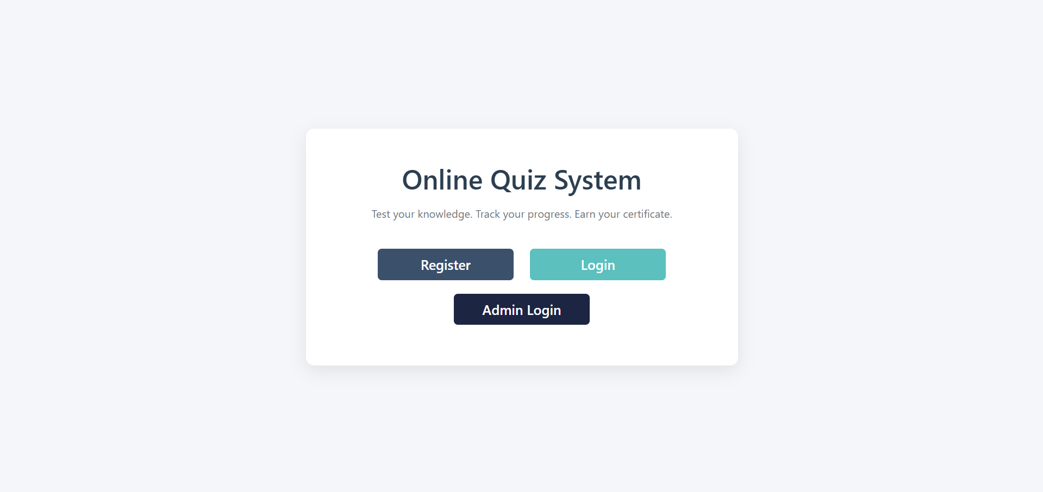

IMPLEMENTATION SCREENSHOTS
HOME PAGE
1
2
3
4
5
6
7
8
9
The home page is the first screen displayed when the Online Quiz System is opened. It allows users to easily navigate to the registration page, login page, or admin login to access and manage the quiz system.

Slide 11
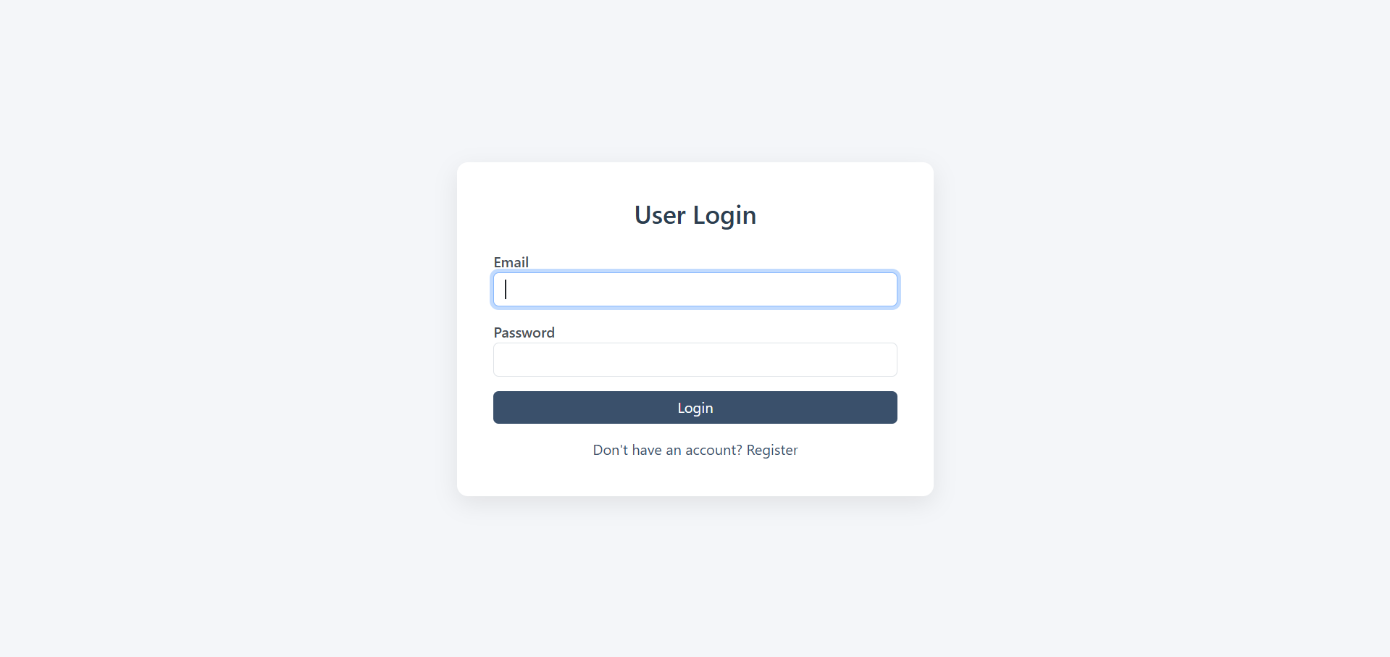
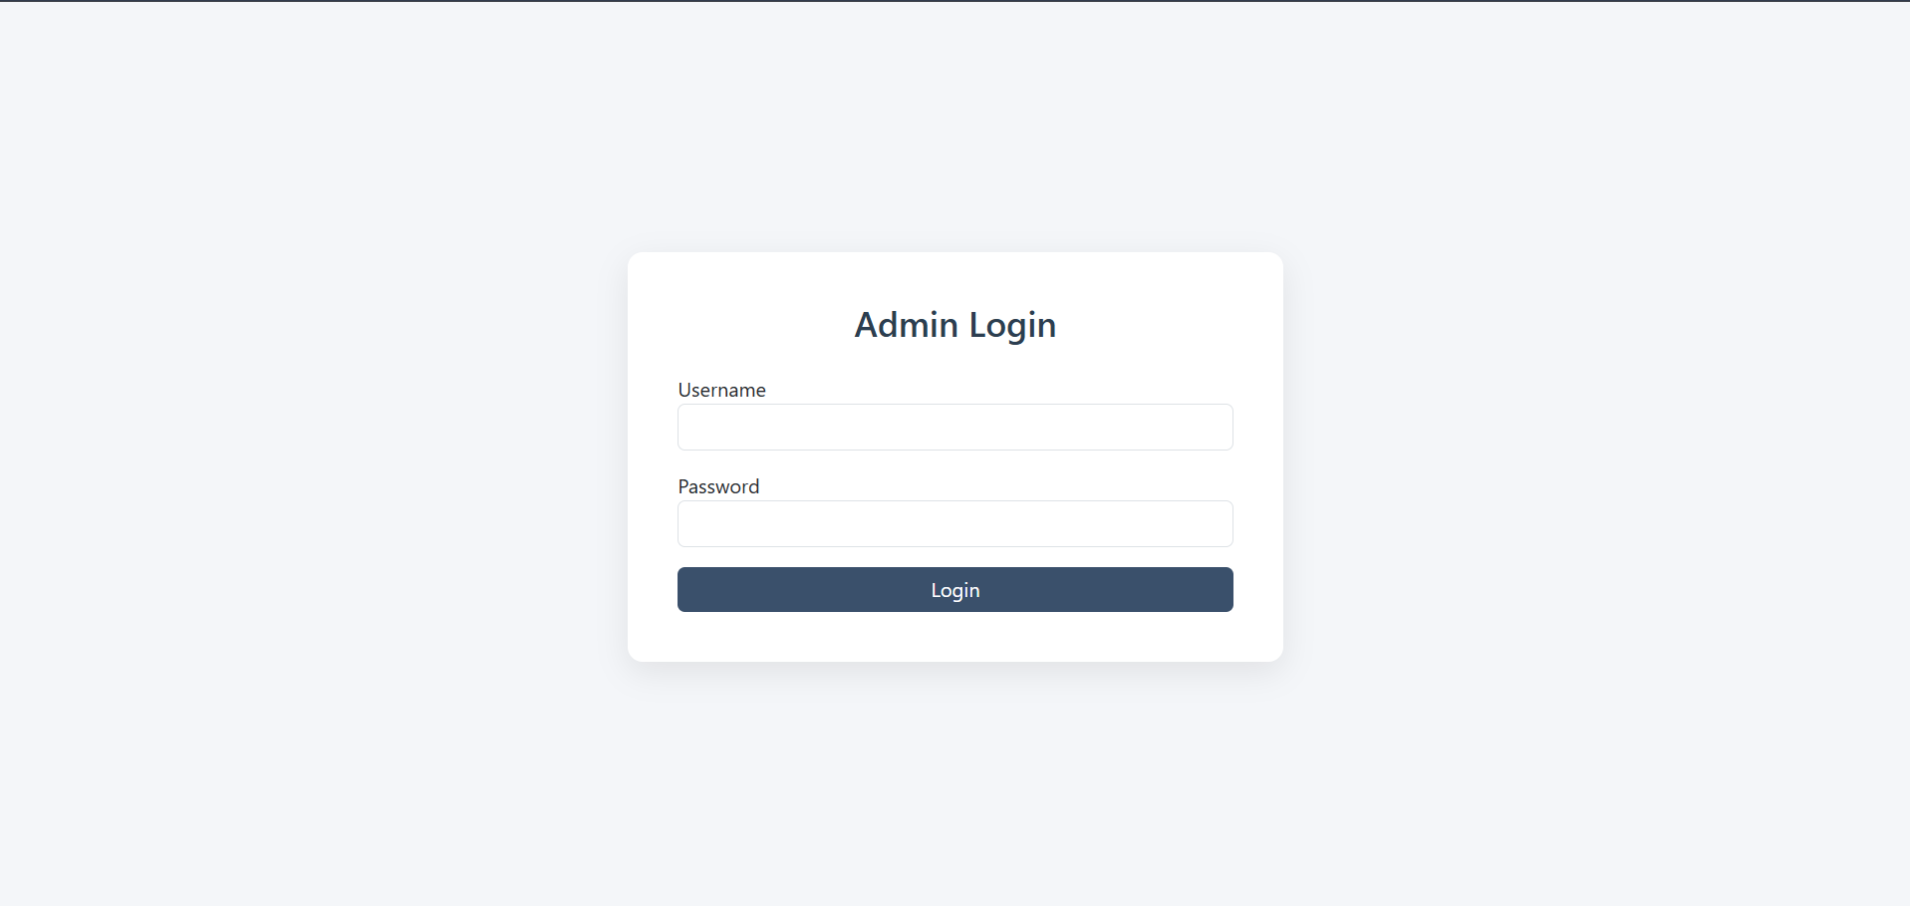
IMPLEMENTATION SCREENSHOTS
LOGIN PAGE
1
2
The user login page allows registered users to securely access the Online Quiz System using their email and password. After successful authentication, users are redirected to the quiz interface where they can attempt the quiz and track their results.
3
4
5
6
7
The admin login page allows the administrator to securely access the system using a username and password. After logging in, the admin can manage quiz questions and control different functionalities of the Online Quiz System.
8(A)
9

Slide 12
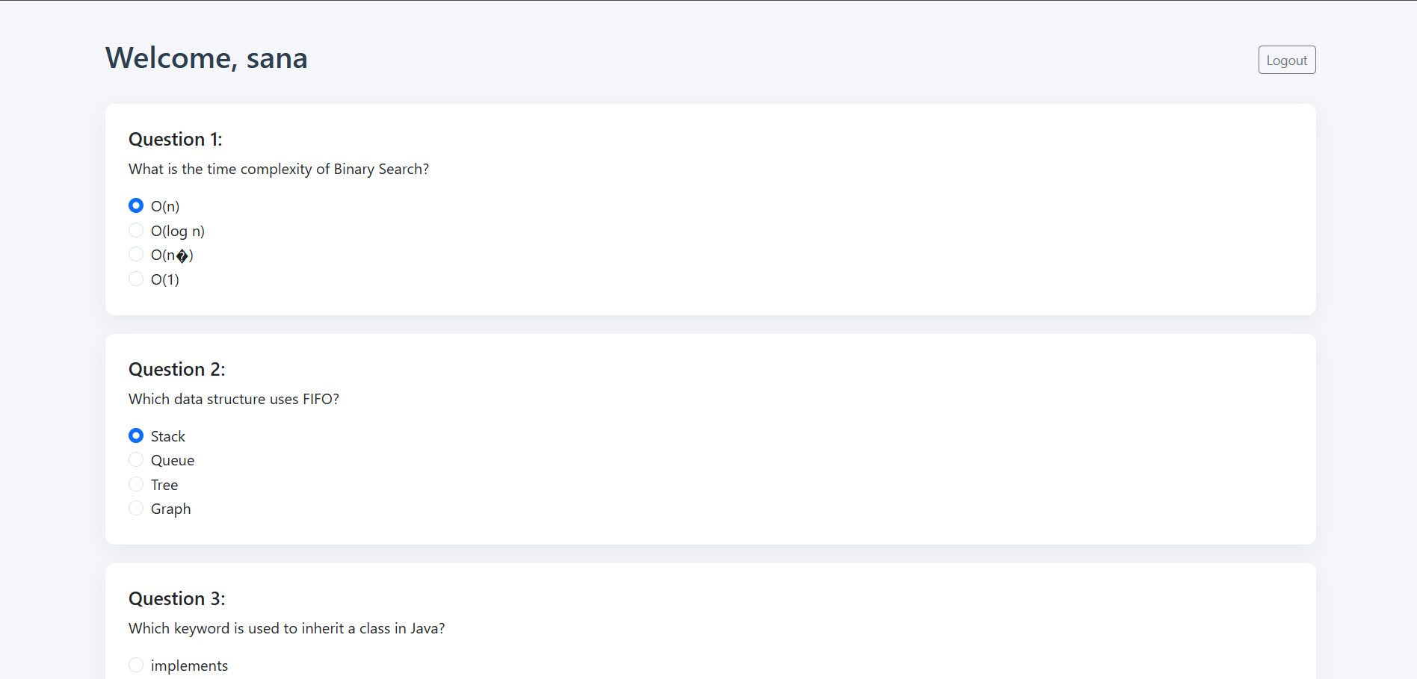
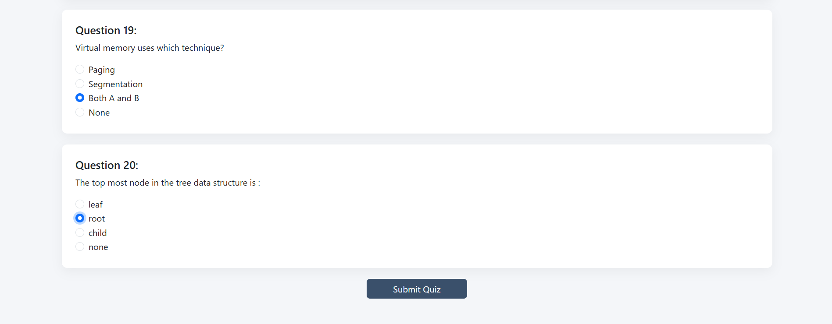
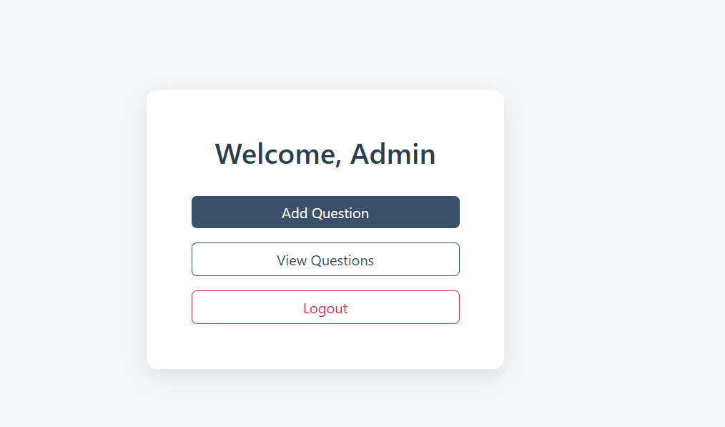
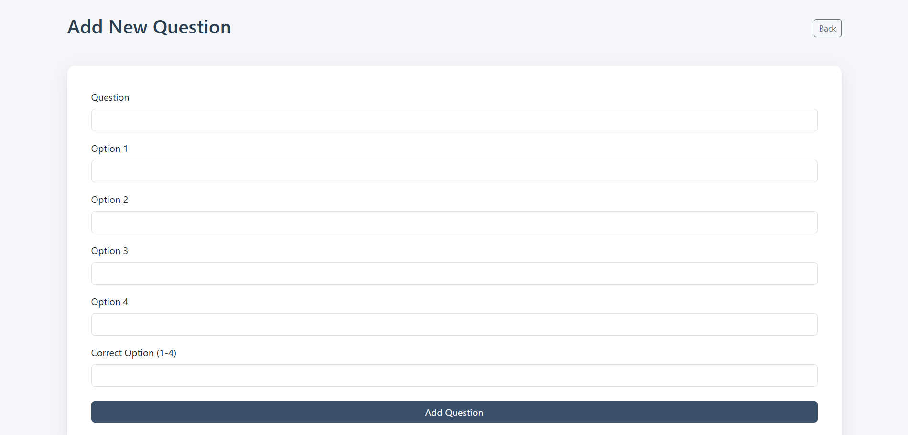
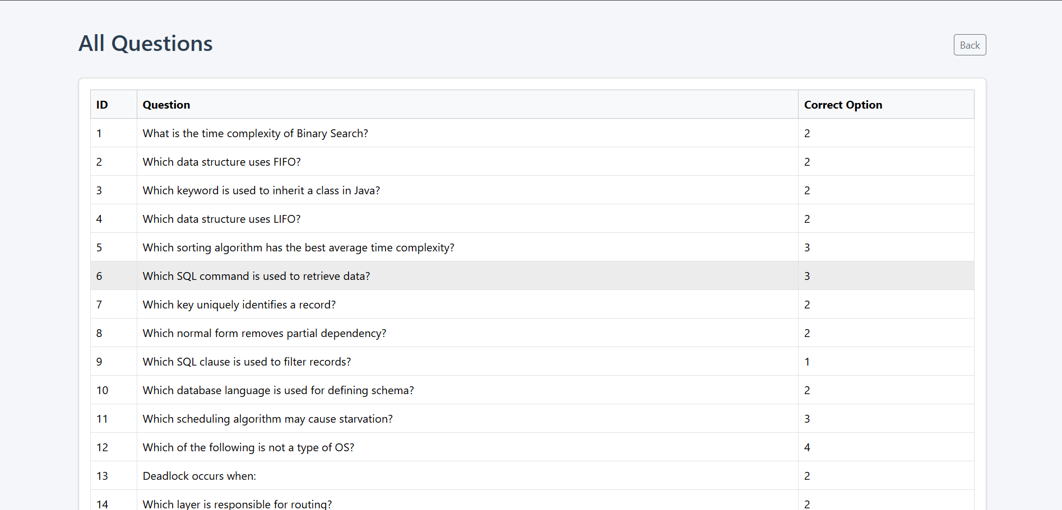
IMPLEMENTATION SCREENSHOTS
MAIN MODULE: QUIZ MODULE
This module shows quiz questions to the user and allows them to select answers. After submission, the system evaluates the responses and calculates the final score.
1
2
3
4
5
6
ADMIN QUESTION MANAGEMENT MODULE
7
This module allows the administrator to add new quiz questions and manage existing questions in the system. It helps maintain and update the quiz content stored in the database.
8(B)
9

Slide 13
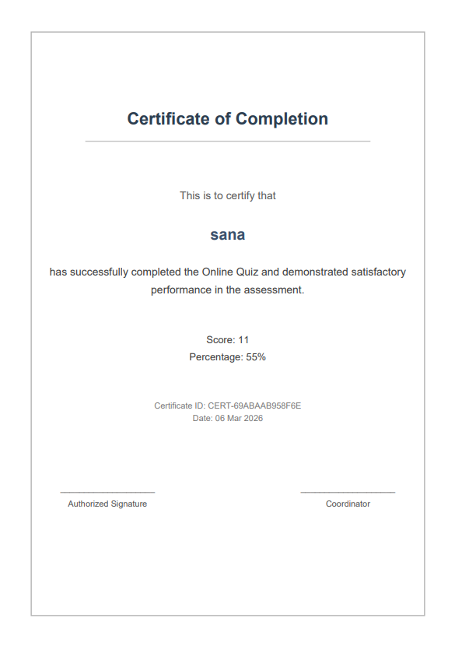
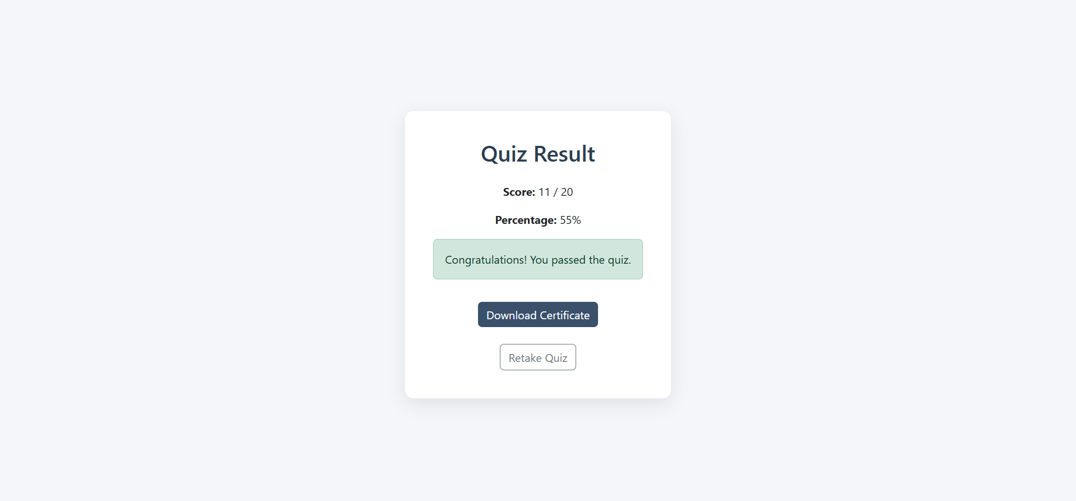
IMPLEMENTATION SCREENSHOTS
OUTPUT:
1
2
3
4
5
6
7
8(C)
The system displays the quiz result after submission, showing the user’s score and percentage. If the user passes the quiz, they can download a certificate of completion generated by the system.
9

Slide 14
ADVANTAGES & LIMITATIONS
ADVANTAGES:
The Online Quiz System provides easy access to quizzes, automatically evaluates answers, and quickly displays results. It also generates certificates for users, making the process efficient and user-friendly.
1
2
3
4
5
6
LIMITATIONS:
The system depends on an internet connection and currently supports only basic quiz functionality. Advanced features such as detailed analytics or multiple quiz categories are not included.
7
8
9

Slide 15
Thank you

